Slide 1
Mining Sequential Patterns by Pattern-Growth:
The PrefixSpan Approach
Jian Pei, Member, IEEE Computer Socity, Jiawei Han, Senior Member, IEEE, Behzad Mortazavi-Asl, Jianyong Wang, Helen, Qiming Chen,
Umeshwar Dayal, Member, IEEE Computer Scoity, and MeiChun Hsu
IEEE Transactions on knowledge and data engineering, Vol. 16, No. 11, November 2004
Presenter: Tsung-Jung Tsai (蔡宗容)
Date: Dec 26, 2007

Slide 2
Abstract (1/3)
Sequential pattern mining is an important data mining problem with broad applications. However, it is also a difficult problem since the mining may have to generate or examine a combinatorially explosive number of intermediate subsequences. Most of the previously developed sequential pattern mining methods, such as GSP, explore a candidate generation-and-test approach to reduce the number of candidates to be examined. However, this approach may not be efficient in mining large sequence database having numerous patterns and/or long patterns.

Slide 3
Abstract (2/3)
In this paper, we propose a projection-based, sequential pattern-growth approach for efficient mining of sequential patterns. In this approach, a sequence database is recursively projected into a set of smaller databases, and sequence patterns are grown in each projected database by exploring only locally frequent fragments. Based on an initial study of the pattern growth-based sequential pattern mining, FreeSpan, we propose a more efficient method, called PSP, which offers ordered growth and reduced projected databases.

Slide 4
Abstract (3/3)
To further improve the performance, a pseudoprojection technique is developed in PrefixSpan. A comprehensive performance study shows that PrefixSpan, in most cases, outperforms the Apriori-based algorithm GSP,FreeSpan,and SPADE, and PrefixSpan integrated with pseudoprojection is the fastest among all the tested algorithms. Furthermore, this mining methodology can be extended to mining sequential patterns with user-specified constraints.

Slide 5
Introduction
Sequential pattern mining, which discovers frequent subsequences as patterns in a sequential database, is an important data mining problem with broad applications, including
  The analysis of customer purchase patterns
  Web access patterns
  The analysis of sequencing or time-related processes
    Scientific experiments
    Natural disasters
    Disease treatments
    The analysis of DNA sequences

Slide 6
Algorithm specification
Input:
(1) Given a set of sequences, where each
sequence consists of a list of elements and
each element consists of a set of items
(2) and given a user-specified min_support
threshold
Output:
sequential pattern mining is to find all frequent subsequences whose occurrence frequency in the set of sequences is no less than min_support
item
element
element
…
sequences
…

Slide 7
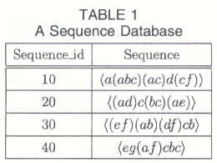

Slide 8

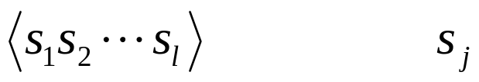

Problem definition (1/2)
item
element
element
…
sequences
itemset
- a subset of items
- demoted by
Sequence
- an ordered list of itemsets
- denoted by , where is an itemsets
Element (itemset)
- an element of the sequence
- denoted by
- element (x) is written as x.
…
itemset)

Slide 9
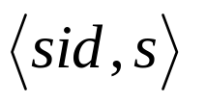
Problem definition (2/2)
item
element
element
…
sequences
length
- the number of instances
of items in a sequence
L-sequence
- a sequence with length L
Sequence database S
- a set of tuples
where sid is a sequence_id and s a sequence
…
element (itemset)

Slide 10
Apriori-like sequential pattern mining method (1/2)
A huge set of candidate sequences could be generated in a large sequence database.
  For example , two frequent sequences of length-1,
  〈a〉 and 〈b〉
  will generate five candidate sequences of length-2:
  〈aa〉, 〈ab〉, 〈ba〉, 〈bb〉, 〈(ab)〉
  If there are 1,000 frequent sequences of length-1, such as
  〈a₁〉, 〈a2〉, …, 〈a₁₀₀₀〉
  will generate 1000² + C(1000, 2) = 1,499,500 cadidate sequences.

Slide 11
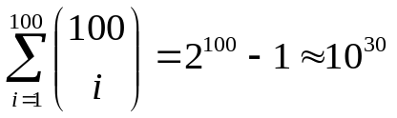
Apriori-like sequential pattern mining method (2/2)
Multiple scans of databases in mining
The a priori-based method generates a combinatorially explosive number of candidates when mining long sequential patterns
  For example,
  given one single sequence of length 100, 〈 a₁ a₂… a₁₀₀ 〉 and the min_support threshold be 1.
  It will generate 100 length-1 candidate sequences,
  100² + C(100, 2) = 14,950 length-2 candidate sequences,
  C(100, 3)=161,700 length-3 candidate sequences, and so on.
  The total number of candidate sequence to be generated is

Slide 12






PrefixSpan: Prefix-Projected Sequential Patterns Mining
Suppose all the items within an element are listed alphabetically. Given a sequence , a sequence
is called a prefix of α if and only if
  (1)
  (2)
  (3) all the frequent items in are
  alphabetically after those in .

Slide 13
An example for the definition
〈a〉, 〈aa〉, 〈a(ab)〉, and 〈a(abc)〉are prefixes of sequence s =〈a(abc)(ac)d(cf)〉,
but neither〈ab〉nor 〈a(bc)〉is considered as a prefix.
  〈a(abc)(ac)d(cf)〉 prefix=〈a〉
  〈a(abc)(ac)d(cf)〉 prefix=〈aa〉
  〈a(abc)(ac)d(cf)〉 prefix=〈a(ab)〉
  〈a(abc)(ac)d(cf)〉 prefix=〈a(abc)〉

Slide 14
An example for PrefixSpan
For the same sequence database S in Table 1 with min_sup = 2

Slide 15
Step-1:
Find length-1 sequential patterns
Scan S once to find all the frequent items in sequences
Each of these frequent items is a length-1 sequential pattern.
They are〈a〉: 4, 〈b〉: 4, 〈c〉: 4, 〈d〉: 3, 〈e〉: 3 and〈f〉: 3.
(〈pattern〉: count)

Slide 16
Step-1:
Find length-1 sequential patterns
〈a〉: 4
〈b〉: 4
〈c〉: 4
〈d〉: 3
〈e〉: 3
〈f〉: 3

Slide 17
Step-2:
Divide search space
The complete set of sequential patterns can be partitioned into 6 subsets according to the 6 prefixes
  (1) the ones with prefix 〈a〉
  (2) the ones with prefix 〈b〉
  …
  (3) the ones with prefix 〈f〉

Slide 18
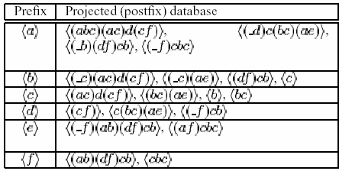
Step-2:
Divide search space

Slide 19
Step-3:
Find subsets of sequential patterns
The subsets of sequential patterns can be mined by constructing the corresponding set of projected databases and mining each recursively.
  a. Find sequential patterns with prefix 〈a〉
  b. Find sequential patterns with prefix 〈b〉,
  〈c〉, 〈d〉, 〈e〉, 〈f〉, respectively.

Slide 20

Step-3:
Find subsets of sequential patterns
By scanning the 〈a〉-projected database once, its locally frequent items are a:2,
b:4, _b:2, c:4, d:2, and f:2.
All the length-2 sequential patterns prefixed with
〈a〉are found, and they are: 〈aa〉:2,
〈ab〉:4, 〈(ab)〉:2, 〈ac〉:4, 〈ad〉:2, and〈af〉:2

Slide 21
Step-3:
Find subsets of sequential patterns
Recursively, all sequential patterns with prefix 〈a〉can be partitioned into six subsets:
  (1) those prefixed with 〈aa〉
  (2) those with 〈ab〉
  …
  (3) those with 〈af〉

Slide 22

Step-3:
Find subsets of sequential patterns
〈aa〉
〈a〉
〈(_bc)(ac)d(cf)〉, 〈(_e)〉
〈ab〉
〈b〉
〈(_c)(ac)d(cf)〉, 〈(_c)(ae)〉,〈c〉
〈(ab)〉
〈(ab)〉
〈(_c)(ac)d(cf)〉, 〈(df)cb〉

Slide 23
Step 4
The set of sequential patterns is the collection of patterns found in the above recursive mining process.

Slide 24
Reduced the size of projected databases – using pseudoprojection
●
2
〈a(abc)(ac)d(cf)〉

Slide 25
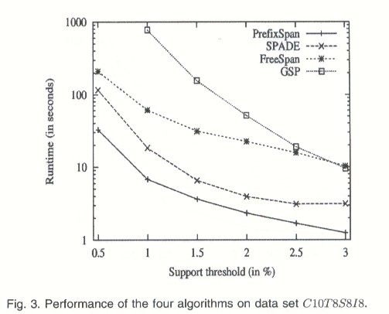
Experimental Results

Slide 26
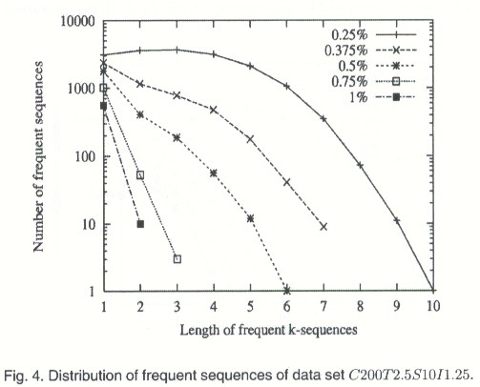
Experimental Results

Slide 27
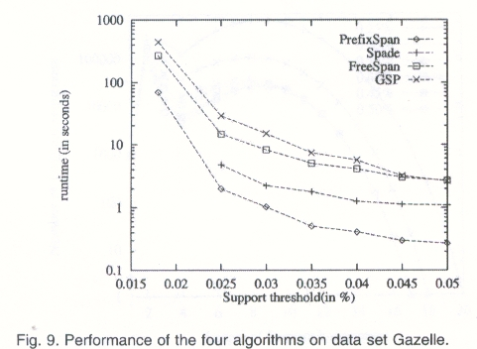
Experimental Results

Slide 28
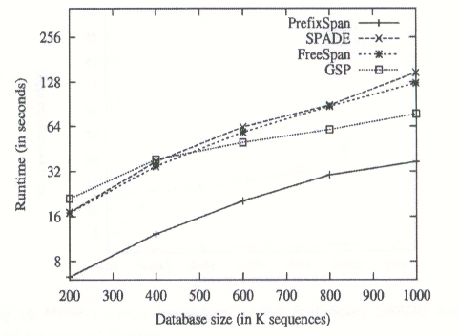
Experimental Results

Slide 29
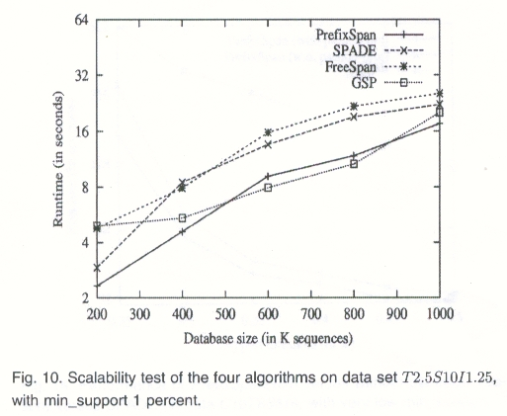
Experimental Results

Slide 30
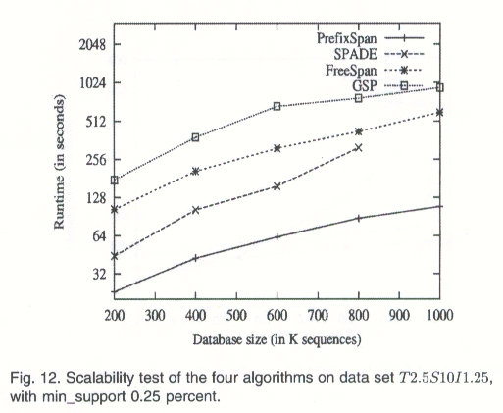
Experimental Results

